Slide 1
English 101 Week 3
Theme: Life balance, the importance of nature

Slide 2
To finish off from last week
Listening on Daydreaming
I read your answers from the listening on daydreaming.
Please go now to see my comments and re-read your answers
Writing - Dialogue
I read your texts and I commented on them.
Please go to you portfolios now to listen to my recorded comments

Slide 3
To finish off from last week
Go to your portfolios. Start a new page. Reflect on what you learned from the daydreaming part of this theme.
New ideas?
New vocabulary or expressions?
Anything about the English language?

Slide 4
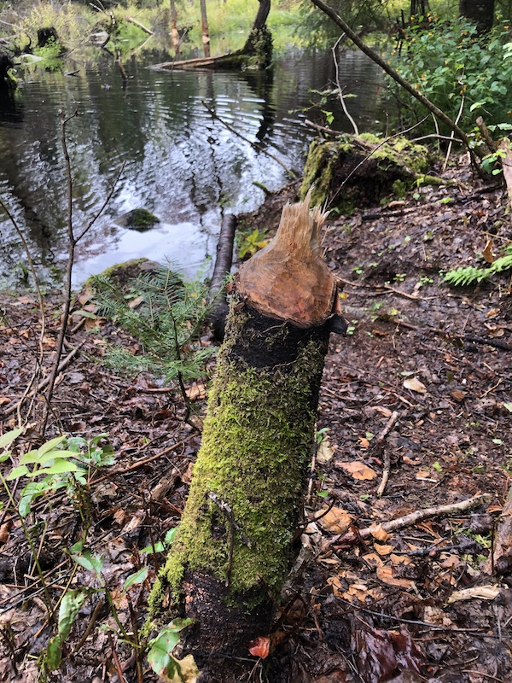
New for this week: Nature
Here is my homework:
This photo is significant to me because it represents the amazing abilities of beavers to change the environment. This is a fresh cut from animals that work all the time. This family of beavers created a new pond, where they now live.
The photo has soft textures and includes the colours of nature, from blue, to brown, to green.

Slide 5
New for this week: Nature
Here is my homework:
This photo is significant to me because it represents the amazing abilities of beavers to change the environment. This is a fresh cut from animals that work all the time. This family of beavers created a new pond, where they now live.
The photo has soft textures and includes the colours of nature, from blue, to brown, to green.

Slide 6
New for this week: Nature
Here is my homework:
In order to take this photo, I convinced my friends to take a walk near my cottage. We hiked to the end of the road and crossed a bridge. We followed the path for about 20 minutes before seeing the beaver pond. I climbed over a stack of logs to get close to the beaver-chewed stump. The walk is a long loop that took about an hour an a half altogether.

Slide 7
New for this week: Nature
Here is my homework:
In order to take this photo, I convinced my friends to take a walk near my cottage. We hiked to the end of the road and crossed a bridge. We followed the path for about 20 minutes before seeing the beaver pond. I climbed over a stack of logs to get close to the beaver-chewed stump. The walk is a long loop that took about an hour an a half altogether.

Slide 8
Simple present and simple past
Simple present | Simple past
Habits, routines, descriptions, something that is always true | An action or a series of actions that started and ended at a time in the past.
Same as infinitive except 3rd person singular requires “s” or “es”. Be and have are exceptions | Formed by adding “d” or “ed” to verb for a regular verb. Irregular forms should be memorized.
Refer to this website if you’re unsure | Refer to this website if you’re unsure. Here is a list of irregular verbs and their past tense forms

Slide 9
Your homework from last week
Please take 10 minutes now to revise the text you used with your photos. Did you use simple present and simple past correctly?
At the time indicated by your teacher, go to your groups, share your photos and texts.

Slide 10
Listening exercise
Start by trying the vocabulary quiz “Get Hooked on Nature” under “assignments”
Note that the vocabulary in the list follows the order in the video
When you have finished with vocabulary, open the comprehension question document in ”files” and review the questions.
Watch the video and answer the questions

Slide 11
Listening exercise – checking your answers
Meet in your groups to compare answers
Ask the teacher for help if there are disagreements about the right answer

Slide 12
Homework
Scenario:
The students in your programme are a little down and you think the solution might be to spend more time in nature.
Read this text and prepare a short talk (maximum 2 minutes) for your classmates to convince them to go outside. Use information from the text, but say it in your own words. Don’t copy from the text.
Next week: reading exam

